Slide 1

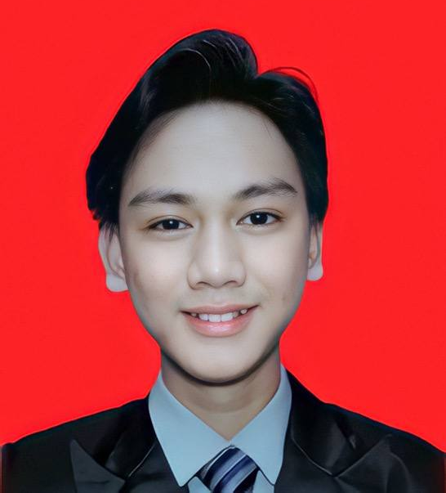
IMPLEMENTING
PERSPECTIVE
SWITCHING
PSM1
FINAL
YEAR
PROJECT
MECHANISM IN IMMERSIVE VR
Experiencing Lieutenant Adnan's Battle from Dual Viewpoints
Using Unreal Engine 5
NAME
ALEX ALVIAN SAMSUL | B032310436
FTMK, UTeM
BITM Program
SUPERVISOR
IKMAL FAIQ ALBAKRI BIN MUSTAFA ALBAKRI
FACULTY
FACULTY OF INFORMATION AND COMMUNICATION TECHNOLOGY
Unreal Engine 5.5
Meta Quest 2
🎮 UE5.5
🥽 Meta Quest 2
🇲🇾 Malaysian Heritage
⚔️ Battle of Pasir Panjang

Slide 2
01 / PROBLEM BACKGROUND
⚔️ Forgotten Hero
📚 Passive Traditional Media
Lt. Adnan bin Saidi, refused to retreat at Battle of Pasir Panjang, 13–14 Feb 1942. Awareness among Malaysian youth is rapidly declining.
Textbooks, documentaries & static museum exhibits present history passively failing to engage digitally-native generations.
Alnagrat 2022
🎮 Limited VR Scope
👤 Weak Character Rep.
Existing VR historical apps offer single-perspective only. No dual-viewpoint experience exists for Malaysian military history.
Current digital portrayals of Lt. Adnan lack realism and emotional depth needed to connect modern audiences.

Slide 3
02 / PROBLEM STATEMENT
Lack of Engaging Historical Presentation
01
Traditional mediums, textbooks, museums, documentaries are passive and fail to create meaningful emotional engagement among younger, digitally-native generations.
Alnagrat 2022
Richardson, 2024
No Dual-Perspective VR Experience
02
Existing VR apps offer single-perspective only. Users cannot experience BOTH Lt. Adnan's command decisions AND the soldier's ground-level combat perspective.
Unconvincing Character Representation
03
Current digital portrayals of Lt. Adnan lack realism and emotional depth failing to convey the humanity and heroism of the man behind the legend.

Slide 4
03 / RESEARCH AIM & OBJECTIVES
🎯 RESEARCH AIM
To develop an immersive VR application using Unreal Engine 5 and custom character assets implementing a perspective switching mechanism, enabling users to experience Lt. Adnan bin Saidi's story from dual viewpoints.
i
Identify the historical background of Lt. Adnan's battle and requirements for developing a VR application with perspective switching using Unreal Engine 5.
ii
Develop a VR application featuring a 3D character representation of Lt. Adnan and a perspective switching mechanism between first-person viewpoints.
iii
Evaluate the effectiveness of the VR application and perspective switching mechanism in supporting historical learning.

Slide 5
04 / SCOPE OF RESEARCH
👥
🖥
🎭
TARGET
AUDIENCE
PLATFORM
GENRE &
THEME
Students, educators & history enthusiasts. Focused on younger, digitally native Malaysians with limited knowledge of Lt. Adnan's story.
Unreal Engine 5.5 deployed on Meta Quest 2 VR headset via Oculus Link cable pipeline for real-time immersive testing.
Historical immersive educational VR. Malaysian heritage preservation through dual-perspective storytelling of 1942.

